Slide 1

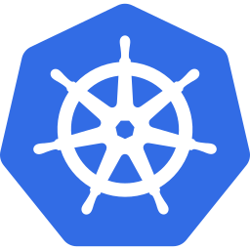
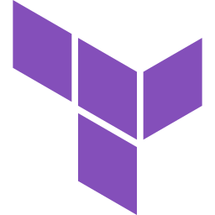

ResolveOps AI
Cloud Native DevOps
Capstone
Azure AKS
Microservices
AI-Powered SRE / AIOps Platform on Azure AKS
AI / LLM
AKS
Terraform
GitHub Actions
Azure AI
GitOps
Sathvik • Cloud Native DevOps Capstone • 2024
Notes:
Welcome everyone. Today I'm presenting ResolveOps AI — my cloud native DevOps capstone project. It's an AI-powered SRE / AIOps platform deployed on Azure AKS using microservices, Terraform IaC, GitHub Actions CI/CD, and Azure managed services. I'll walk through the problem, the architecture, CI/CD, security, and a live demo flow.

Slide 2
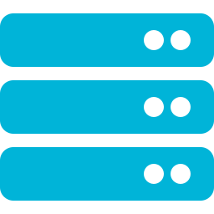

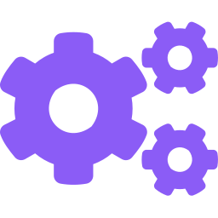
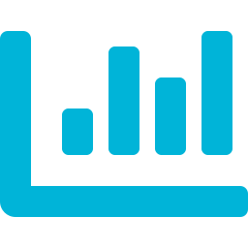
The Problem
Modern cloud operations are overwhelming teams
Modern cloud systems generate thousands of signals, incidents, logs, and pipeline failures — teams cannot keep up.
Siloed Observability
Pipeline Blindness
Multi-Cloud Complexity
Metrics, logs, traces scattered across Azure, AWS, GitHub with no unified view
CI/CD failures require manual log diving — no intelligent root cause analysis
Teams manage Azure and AWS resources independently without correlation
Alert Fatigue
Manual RCA
No Cost Visibility
Engineers receive hundreds of low-context alerts with no remediation guidance
Root cause analysis takes hours — incidents stay open while revenue is lost
Cloud spend anomalies go undetected until the monthly bill arrives
Notes:
Modern engineering teams face a crisis of signal overload. GitHub CI/CD failures, Azure alerts, AWS anomalies, and Kubernetes pod crashes all need triage simultaneously. Manual root cause analysis is too slow. Teams need an intelligent platform that correlates signals, surfaces root causes, and recommends fixes automatically.

Slide 3
ResolveOps AI — Solution Overview
One intelligent platform for SRE, incident intelligence, and cloud health
GitHub Pipelines
AI Root Cause Analysis
ResolveOps AI
Platform
Azure Resources
Smart Notifications
AWS Resources
Incident Dashboard
Centralized Visibility
Automated RCA
Cost Insights
Zero-Trust Security
Notes:
ResolveOps AI ingests data from GitHub CI/CD pipelines, Azure resources, and AWS resources. It applies AI-driven root cause analysis, sends intelligent notifications, and presents everything in a unified dashboard showing incidents, costs, health scores, and recommendations.

Slide 4
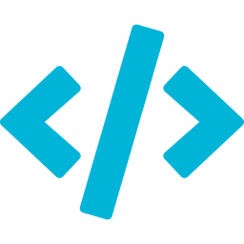
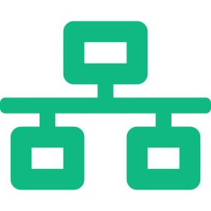

Microservice Architecture
8 purpose-built services with separation of concerns
frontend
api-gateway-service
auth-service
github-intelligence-service
React UI dashboard — incidents, cost, health
Single entry point, routing, JWT validation
Entra ID OAuth2, token exchange & validation
Fetches pipeline runs, workflow failures, PRs
azure-intelligence-service
aws-intelligence-service
ai-rca-service
notification-service
Polls Azure Monitor, resource health, costs
Reads CloudWatch, EC2/RDS/Lambda health
LLM-powered root cause analysis & remediation
Sends email/Slack alerts via Service Bus
Notes:
Each service has a single responsibility. The frontend calls only the API Gateway, which routes requests to the correct intelligence service. Auth is centralized. The AI RCA service aggregates findings. The notification service decouples alert delivery from business logic. All services communicate via internal Kubernetes ClusterIP.

Slide 5
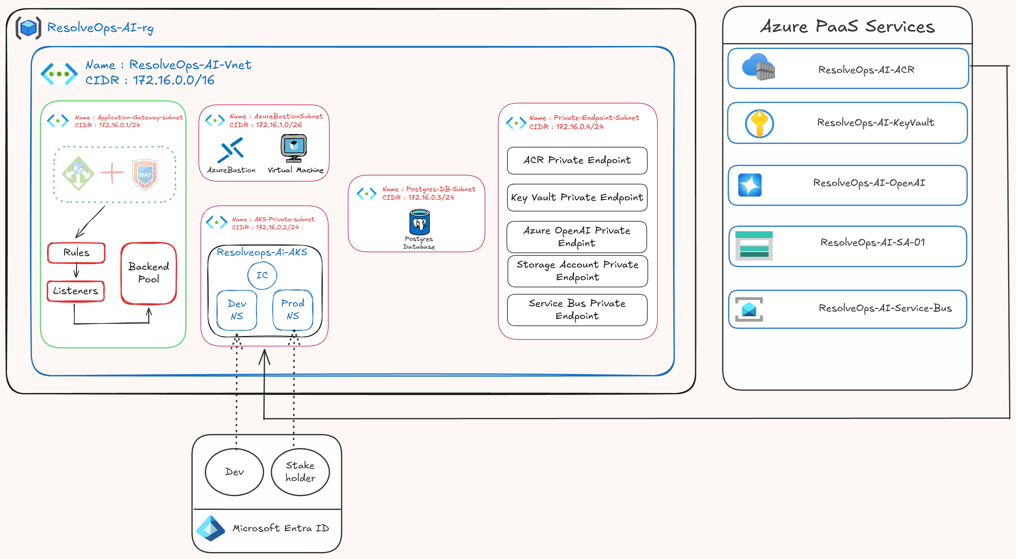
Azure Infrastructure Architecture
Hub-spoke VNet design with private endpoints and AKS
Notes:
This is the actual Azure architecture diagram for ResolveOps AI. The VNet (172.16.0.0/16) contains four subnets: Application Gateway subnet with WAF, AzureBastion subnet, AKS Private subnet with Dev and Prod namespaces, Private Endpoint subnet for ACR, Key Vault, OpenAI, Storage, and Service Bus. All PaaS services use private endpoints. Microsoft Entra ID handles user authentication for Devs and Stakeholders.

Slide 6




CI/CD Architecture
GitHub Actions reusable workflows — build, scan, push, deploy, infra
Developer
Push
Tests
unit/int
SonarQube
SAST
Snyk
Dep Scan
Docker
Build
Trivy
Image Scan
Push to
ACR
Deploy to
AKS
Kustomize Manifests → AKS namespace overlay (dev / prod)
Terraform Infrastructure Pipeline
terraform fmt/validate
tfsec / Checkov scan
terraform plan
manual approval gate
terraform apply
✔ Reusable workflow templates • GitHub Environments (dev/prod) • Required reviewer approvals • GitHub Secrets for pipeline credentials; application secrets stored in Azure Key Vault
Notes:
There are two pipelines. The service pipeline runs on every push to main: unit tests, SonarQube SAST, Snyk dependency scan, Docker build, Trivy image scan, push to ACR, then deploy via Kustomize overlays to AKS. The infrastructure pipeline runs Terraform with security scanning (tfsec, Checkov), plan review, manual approval, then apply. All credentials are stored in GitHub Secrets.

Slide 7
Kubernetes Deployment Design
AKS cluster with isolated namespaces, ingress, and resource governance
ResolveOps-AI-AKS (Azure Kubernetes Service)
NGINX Ingress Controller
resolveops-dev
resolveops-prod
frontend
api-gateway
frontend
api-gateway
auth-service
github-intel
auth-service
github-intel
azure-intel
aws-intel
azure-intel
aws-intel
ai-rca
notification
ai-rca
notification
Deployments • Services (ClusterIP) • ConfigMaps • Secrets • ServiceAccounts • Probes • Resource Limits
Notes:
The AKS cluster hosts two namespaces: resolveops-dev and resolveops-prod. Each namespace contains all 8 services deployed as Kubernetes Deployments with liveness and readiness probes, resource requests and limits, and multiple replicas. Backend services use ClusterIP. The frontend and API Gateway are exposed through an NGINX Ingress Controller. Namespace isolation prevents cross-environment traffic.

Slide 8
Microsoft Entra ID & Access Control
Zero-trust identity: OAuth2 + RBAC + namespace isolation
User / Dev
/ Stakeholder
Microsoft
Entra ID
JWT
Token
Kubernetes
RBAC
ResolveOps-Dev-Users
ResolveOps-Prod-Users
↓ maps to namespace
↓ maps to namespace
resolveops-dev (read/exec only)
resolveops-prod (restricted access)
kubectl exec / get / logs — no cluster-admin
Entra group membership enforced — no cross-namespace access
Notes:
Authentication uses Microsoft Entra ID with OAuth2 and app registration. Users receive a JWT token which is validated by the auth-service. Kubernetes RBAC ClusterRoleBindings map Entra ID groups to namespaces — ResolveOps-Dev-Users can only access the dev namespace, ResolveOps-Prod-Users can only access prod. No service account has cluster-admin privileges.

Slide 9

Azure Workload Identity
Zero static credentials — federated identity for pod-to-cloud access
Kubernetes
Pod
K8s Service
Account
Federated
Credential
Managed
Identity (MI)
Azure
Services
Azure Storage
Blob / Queue
Azure Key
Vault (secrets)
Azure Service
Bus (events)
Azure OpenAI
(LLM calls)
Why Workload Identity?
✔ No client secrets or access keys stored in pods or Kubernetes Secrets
✔ OIDC token issued by AKS is trusted by Azure AD — short-lived, auto-rotated
✔ Managed Identity scoped to exact Azure resources — least privilege
✔ Works with Azure SDK (DefaultAzureCredential) — zero code changes
Notes:
Workload Identity eliminates static credentials entirely. Each pod has a Kubernetes ServiceAccount annotated with an Azure Managed Identity client ID. AKS issues an OIDC token to the pod, which Azure AD validates via a Federated Credential. The pod then receives a short-lived Azure access token scoped to the exact resources it needs — Storage, Key Vault, Service Bus, or OpenAI.

Slide 10
Internal Application Request Flow
End-to-end request journey through the microservice mesh
User
Browser
Frontend
React
API
Gateway
Auth
Validation
Intelligence
Service
AI RCA
Service
Notification
Service
Dashboard
Response
GitHub Failure Analysis
Azure Resource Health
AI Root Cause Analysis
Email / Slack Alert
Notes:
A user opens the dashboard, which calls the API Gateway. The gateway validates the JWT via auth-service, then routes to the requested intelligence service. For example, a GitHub failure triggers the github-intelligence-service, which passes findings to ai-rca-service. The AI generates a root cause and remediation steps, which are sent via notification-service as email or Slack alerts, and displayed in the dashboard.

Slide 11
Security, Monitoring & Reliability
Defence in depth — shift-left scanning, zero-trust, and observability
Secrets & Identity
Code & Image Scanning
✔ No hardcoded secrets anywhere
✔ SonarQube — SAST code quality
✔ GitHub Secrets for pipeline credentials only
✔ Snyk — dependency vulnerabilities
✔ Azure Key Vault + Secrets Store CSI Driver for pod secrets
✔ Trivy — container image CVEs
✔ Workload Identity removes need for static secrets in pods
✔ Checkov — IaC policy scan
Reliability & HA
Observability
✔ Liveness & readiness probes
✔ Azure Monitor & Log Analytics
✔ Multiple replicas per service
✔ Application Insights (APM)
✔ CPU & memory resource limits
✔ Container Insights for AKS
✔ Pod disruption budgets
✔ Structured JSON logging
Notes:
Security is applied at every layer. In the pipeline: SonarQube, Snyk, and Trivy scan before any image reaches ACR. Terraform is scanned with Checkov and tfsec. At runtime: Workload Identity means no credentials in pods. Kubernetes Secrets hold config values. Reliability is built-in via probes, replicas, and resource limits. Observability uses Azure Monitor, Log Analytics, and Application Insights.

Slide 12
Implementation Challenges & Resolutions
Key problems faced during migration, deployment design, and security hardening
⚠ Initially planned a 12-repo microservice split
⚠ Application secrets considered for K8s Secrets / ConfigMaps
✔ Consolidated into 3-repo capstone structure: resolveops-application, resolveops-cicd, resolveops-infrastructure. Simplified evaluation and reduced overhead.
✔ Moved all sensitive secrets to Azure Key Vault. ConfigMaps hold only non-sensitive values. Pods access secrets via Workload Identity + Secrets Store CSI Driver.
⚠ Private AKS API server unreachable from GitHub-hosted runners
⚠ Terraform design risk: too complex and costly from day one
✔ Documented requirement for a self-hosted runner inside the Azure VNet or deployment via Bastion/jumpbox VM for private AKS environments.
✔ Modular design with low-cost dev defaults. Expensive resources toggled via variables: enable_service_bus, enable_private_endpoints, enable_app_gateway, enable_postgres.
⚠ Security scans initially planned but could be bypassed as warnings
⚠ Some services partially scaffolded; API Gateway contains extractable logic
✔ Made all security gates blocking. SonarQube, Snyk, Trivy, and Checkov must pass before image push, deploy, or terraform apply. No soft-fail or continue-on-error.
✔ Kept logic stable for capstone delivery. Phase 2: extract auth, Azure intelligence, and RAG logic into dedicated services after core DevOps pipeline is stable.
Notes:
During implementation, the biggest challenge was balancing enterprise architecture with the actual capstone requirement. Initially, we moved toward a full 12-repo microservice organization, but later aligned the project with the required 3-repo structure. We also improved the security model by moving application secrets into Azure Key Vault instead of Kubernetes Secrets. Another key challenge was private AKS deployment, because GitHub-hosted runners cannot directly reach a private AKS API server. For Terraform, we kept the design modular but simple, with optional toggles to control cost. Finally, all security scans were made mandatory so that vulnerable code, images, or infrastructure cannot move forward in the pipeline.

Slide 13

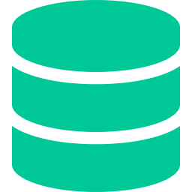
Demo Flow & Future Improvements
Live walkthrough + roadmap to production-grade GitOps
Live Demo Flow
Future Improvements
1
Terraform pipeline creates all Azure infra
Helm Umbrella Chart
Package all 8 services into a single Helm release
2
Service pipeline builds, scans & pushes image to ACR
Argo CD GitOps
Declarative continuous delivery with sync policies
3
Application repo deploys Kustomize manifests to AKS
Prometheus + Grafana
Open-source metrics & dashboards replacing Monitor
4
Frontend loads — Dashboard shows pipeline health
Network Policies
Restrict pod-to-pod traffic beyond namespace isolation
5
API Gateway health endpoint returns 200 OK
Multi-Region Deployment
Active-active across Azure regions for HA
6
Pod accesses Azure Storage via Workload Identity
DR & Backup Strategy
7
AI RCA generates root cause from injected failure
Geo-redundant storage, AKS backup, RTO/RPO targets
Cost Dashboard
8
Notification service sends email / Slack alert
Real-time Azure cost anomaly detection and budgets
Notes:
The demo starts with the Terraform pipeline creating infrastructure. Then the service pipeline builds and pushes the image. The config repo deploys to AKS. We verify the frontend loads, the API is healthy, pods access Azure Storage via Workload Identity (no credentials!), and the AI RCA works end-to-end with notification delivery. Future work includes Argo CD for GitOps, Prometheus/Grafana for metrics, Helm umbrella chart, network policies, and multi-region DR.

